Slide 1
Name
Selected theory: Self-Care Deficit Theory

Slide 2
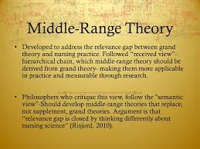
Introduction
The selected middle-range theory to be addressed in this presentation is Orem’s self-care deficit theory.
Self-care is the action of a person willing to develop the capabilities to take care of themselves in their environmental situations (Ali, 2018).
The self-care deficit theory is applicable in transforming human life, and the fascinating thing is that people can lead quality lives.
The theory enables people to change their lifestyles and focus on essential issues.
Notes:
The selected middle-range theory to be addressed in this presentation is Orem’s self-care deficit theory. Self-care is the action of a person willing to develop the capabilities to take care of themselves in their environmental situations (Ali, 2018). The self-care deficit theory is applicable in transforming human life, and the fascinating thing is that people can lead quality lives. The approach enables people to change their lifestyles and focus on essential issues.

Slide 3
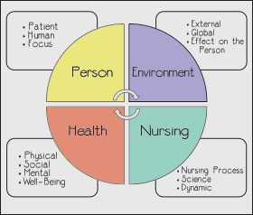
How Self-care Deficit Addresses Nursing Metaparadigm
There are four basic meta paradigms in nursing; person, environment, health, and nursing.
The metaparadigm of the person who is the recipient of care may include individuals, patients, groups, families, and communities.
For a person to stay healthy, there is a need to focus on the necessity of a quality life, and this takes personal actions that will help them stay healthy (Smith & Liehr, 2018).
The recipients of care have to fight to stay healthy, which involves the management of a better lifestyle that amounts to a quality life.
Notes:
There are four basic meta paradigms in nursing; person, environment, health, and nursing. The metaparadigm of the person who is the recipient of care may include individuals, patients, groups, families, and communities. For a person to stay healthy, there is a need to focus on the necessity of a quality life, and this takes personal actions that will help them stay healthy (Smith & Liehr, 2018). The recipients of care have to fight to stay healthy, which involves the management of a better lifestyle that amounts to a quality life.

Slide 4
Continuation
In the metaparadigm of environment, both external and internal issues matter a lot in self-care.
People have to prepare the environment, including friends and families, to focus on taking actions regarding their health.
Besides, the metaparadigm of health matters a lot, and it is defined as the degree of wellness that can be attained by self-care theory in a broader perspective (Smith & Liehr, 2018).
Lastly, the metaparadigm of nursing addresses the need to provide care to people. For doctors to take care of other people, there is a need to understand the concept of self-care first.
The ultimate goal of nursing theories is to promote patient care, and the patients should be made to understand the significance of each metaparadigm for a quality life.
Notes:
In the metaparadigm of environment, both external and internal issues matter a lot in self-care. People have to prepare the environment, including friends and families, to focus on taking actions regarding their health. Besides, the metaparadigm of health matters a lot, and it is defined as the degree of wellness that can be attained by self-care theory in a broader perspective. Lastly, the metaparadigm of nursing addresses the need to provide care to people. For doctors to take care of other people, there is a need to understand the concept of self-care first. The ultimate goal of nursing theories is to promote patient care, and the patients should be made to understand the significance of each metaparadigm for a quality life.

Slide 5
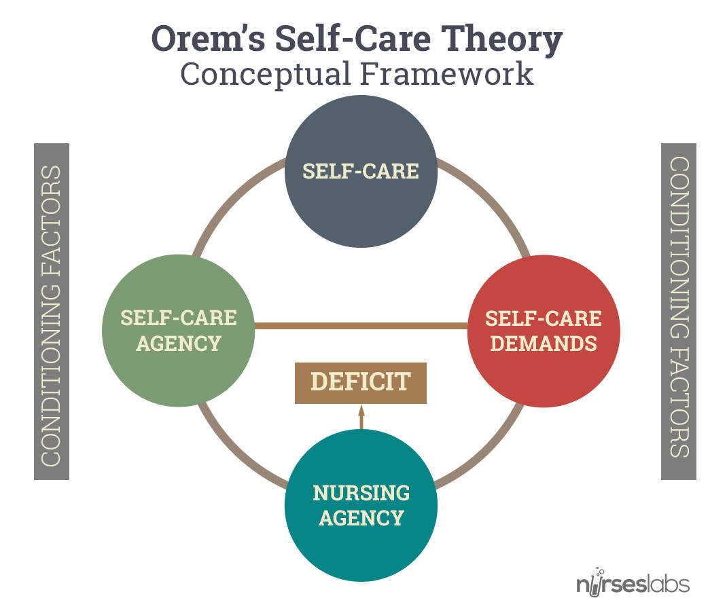
Reflection
The self-care deficit theory fits in my clinical setting in that patients will get educated on the necessity of committing to stay healthy.
Patient education is necessary for transforming people’s lives, which will help understand the significance of taking care of their lives (Borji et al., 2017).
In the incidence of type 2 diabetes patients, self-care deficit theory is applied by educating the patients on broader perspectives of care and what they have to do to lower the intensity of the infection.
Another example of the application of self-care deficit theory is to help people adopt balanced diets and refrain from sedentary lifestyles as that promotes the elimination of diseases and hence good health.
Notes:
The self-care deficit theory fits in my clinical setting in that patients will get educated on the necessity of committing to stay healthy. Patient education is necessary for transforming people’s lives, which will help understand the significance of taking care of their lives (Borji et al., 2017). In the incidence of type 2 diabetes patients, self-care deficit theory is applied by educating the patients on broader perspectives of care and what they have to do to lower the intensity of the infection. Another example of the application of self-care deficit theory is to help people adopt balanced diets and refrain from sedentary lifestyles as that promotes the elimination of diseases and hence good health.

Slide 6
References
Ali, B. H. I. (2018). Application of Orem self care deficit theory on psychiatric patient. Annals of Nursing and Practice, 5(1), 1-3.
Borji, M., Otaghi, M., & Kazembeigi, S. (2017). The impact of Orem’s self-care model on the quality of life in patients with type II diabetes. Biomedical and Pharmacology Journal, 10(1), 213-220.
Smith, M. J., & Liehr, P. R. (Eds.). (2018). Middle range theory for nursing. Springer Publishing Company.

